Slide 1
The Converging Worlds of IoT and Systems Monitoring
How to continuously monitor your power systems for ultimate reliability and efficiency
Jean-Francois Rivard Hitachi Ventara / Pentaho Sr Solutions Engineer
December 28, 2017
Notes:
Pentaho is a data integration and analytics platform and is part of Hitachi Vantara. For those who don’t know, Hitachi Vantara is a new company created within the Hitachi family by combining Pentaho, HDS and HIG to help customers with digital transformation. We were announced in September.
Tonight I want to talk to you about the converging worlds of BD and IoT. And the importance of adding big data context to sensor data.

Slide 2

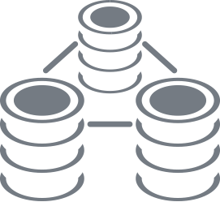
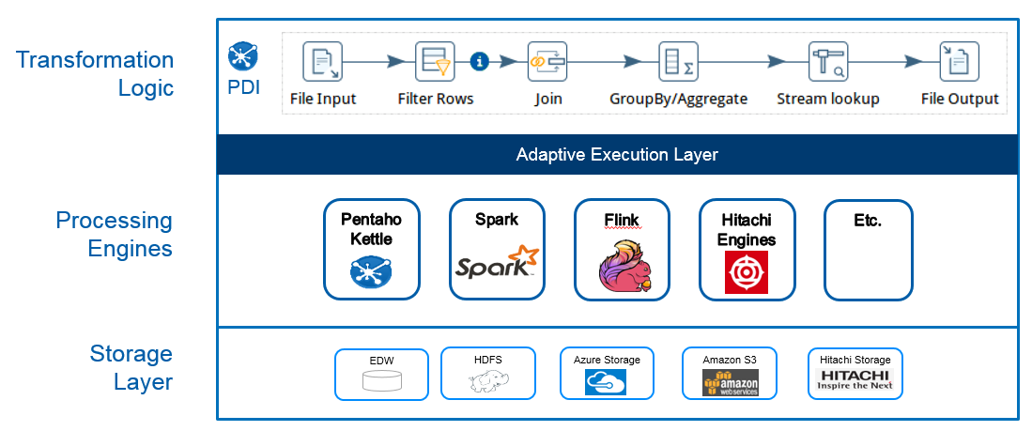




Agenda
IoT Growth
Industry Figures
Monitoring for efficiency
Demo Business Analytics
Pentaho Data Integration / Machine Learning
Integration Demo
Conclusion

Slide 3
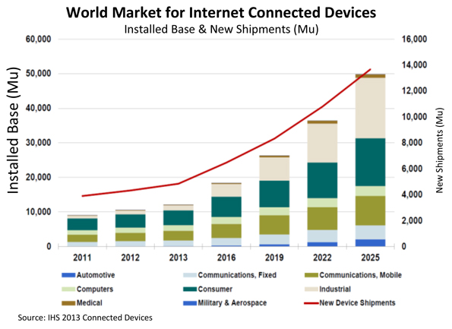
IoT Growth
Gartner says…
The growth in IoT will far exceed that of other connected devices. By 2020 the number of devices, and PC’s will reach about 7.3 billion units.
IoT will have expanded at a much faster rate, resulting in a population of about 26 billion units.
Peter Middleton, Research Director, Gartner

Slide 4
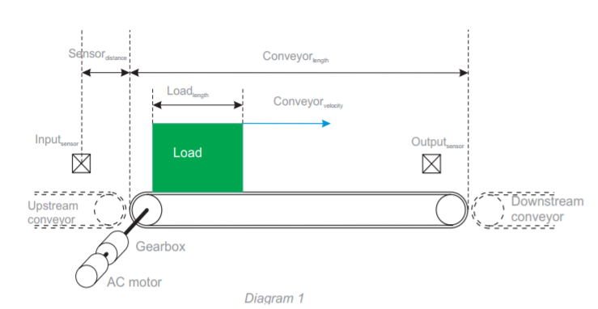
Monitoring Systems for Reliability and Efficiency
With more than 2.5 million conveyors operated annually worldwide, conveying consumes a lot of energy ¹
Motor driven systems, such as conveyor use 70% of the electrical load in an industrial facility ²
Keeping the equipment in top shape means increased production capacity and energy savings
¹www.mhi.org “how to reduce energy costs on conveyor systems
²Schneider Electric “Optimizing energy efficiency od conveyors”
Notes:
All information is combined into an easy to use dashboard designed Provide your management with the complete picture
The level of interaction can be tailored to the user types / groups and delivered on all popular mobile platforms
Information be analyzed with sophisticated visualizations such as
Heat grids, Scatter graphs
Interactive geographic maps
3d graphs, and more
Logitech:
Out of the box reports / dashboards
Automatic alerts to uncover potential issues before they arise
Simplified their complex data integration processes, making them easier to maintain
Bottom Line quote: “Pentaho has improved our ability to manage the business effectively”

Slide 5

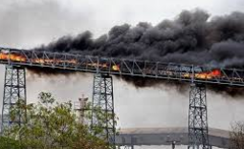
Industrial Equipment Monitoring
Conveyor systems failure can cause minor production mishaps to serious catastrophes..
Proper monitoring can save millions in total ownership and operations costs
Equipment management solutions fully integrate your information from sensor to alerts, reports, dashboards, and predictive analytics
Notes:
All information is combined into an easy to use dashboard designed Provide your management with the complete picture
The level of interaction can be tailored to the user types / groups and delivered on all popular mobile platforms
Information be analyzed with sophisticated visualizations such as
Heat grids, Scatter graphs
Interactive geographic maps
3d graphs, and more
Logitech:
Out of the box reports / dashboards
Automatic alerts to uncover potential issues before they arise
Simplified their complex data integration processes, making them easier to maintain
Bottom Line quote: “Pentaho has improved our ability to manage the business effectively”

Slide 6

Streamlined Optimization
Hitachi combines cutting-edge technology, mechanical engineering, and industry experience to deliver IoT-enabled solutions
Streamline energy management and systems integration
Gain visibility into the health of your facilities including:
Energy use
Predictive Maintenance
Troubleshooting
Safety, and more.
Notes:
All information is combined into an easy to use dashboard designed Provide your management with the complete picture
The level of interaction can be tailored to the user types / groups and delivered on all popular mobile platforms
Information be analyzed with sophisticated visualizations such as
Heat grids, Scatter graphs
Interactive geographic maps
3d graphs, and more
Logitech:
Out of the box reports / dashboards
Automatic alerts to uncover potential issues before they arise
Simplified their complex data integration processes, making them easier to maintain
Bottom Line quote: “Pentaho has improved our ability to manage the business effectively”

Slide 7
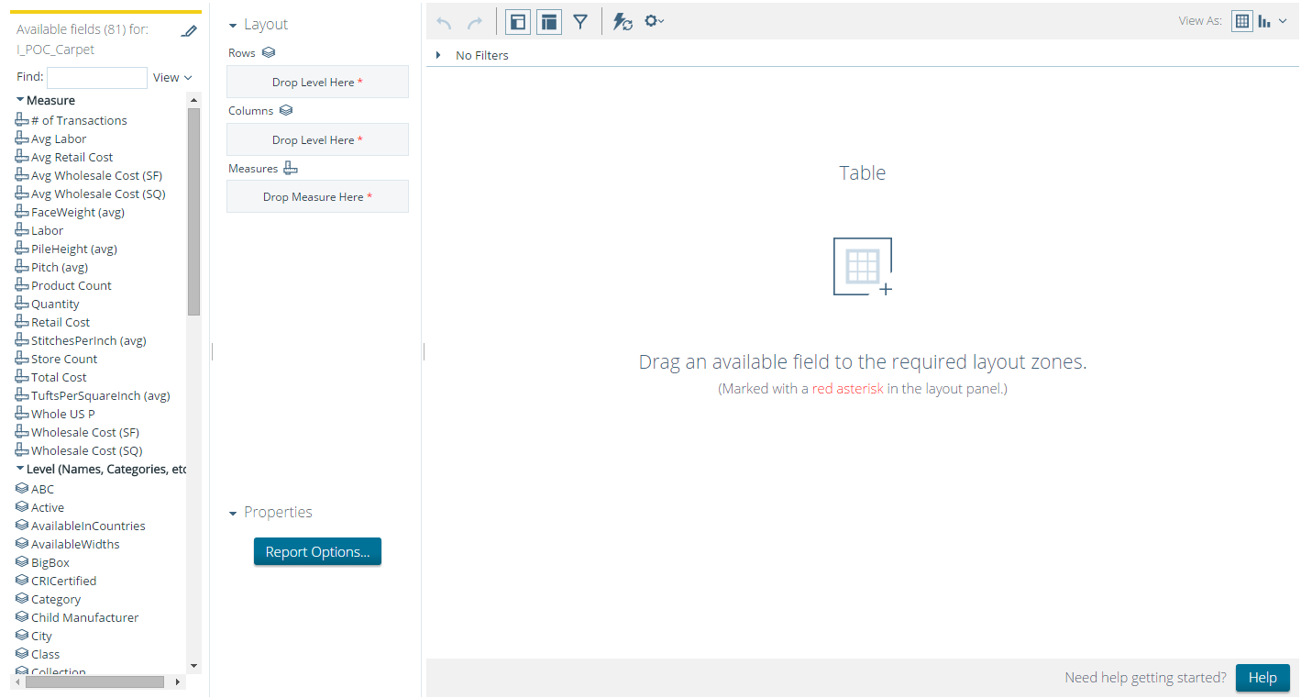
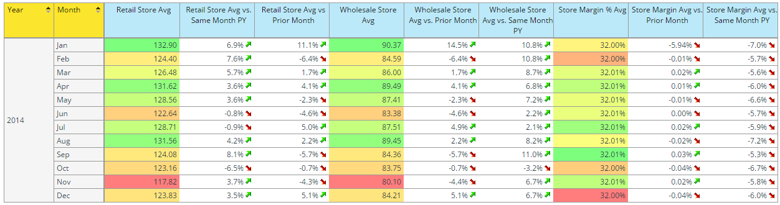
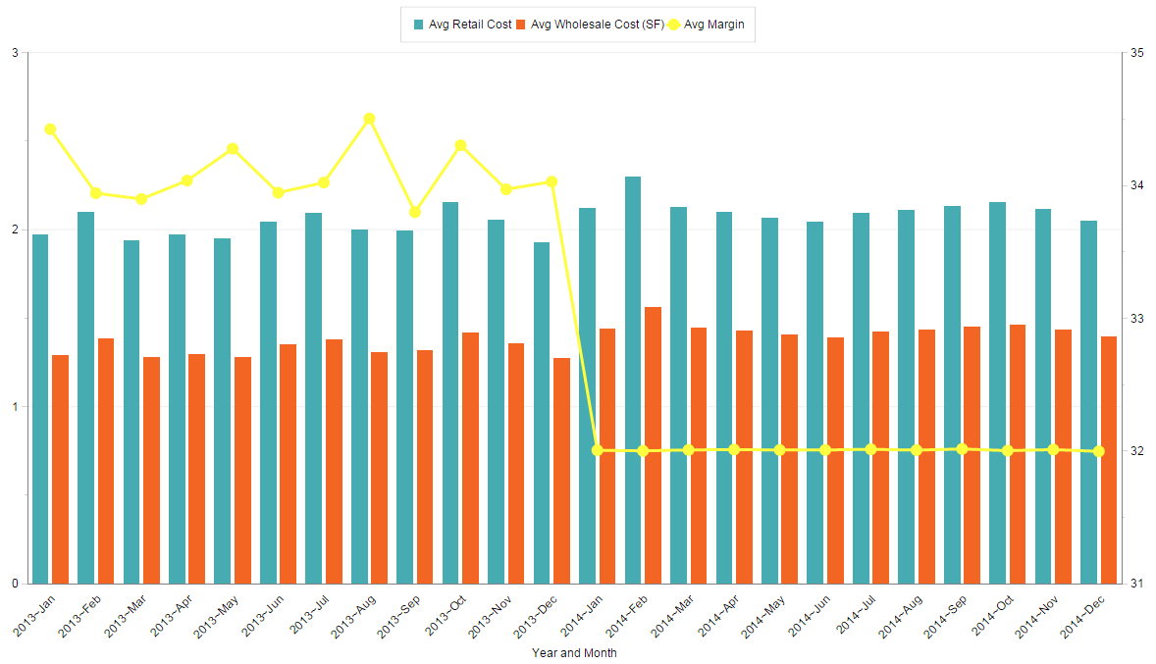
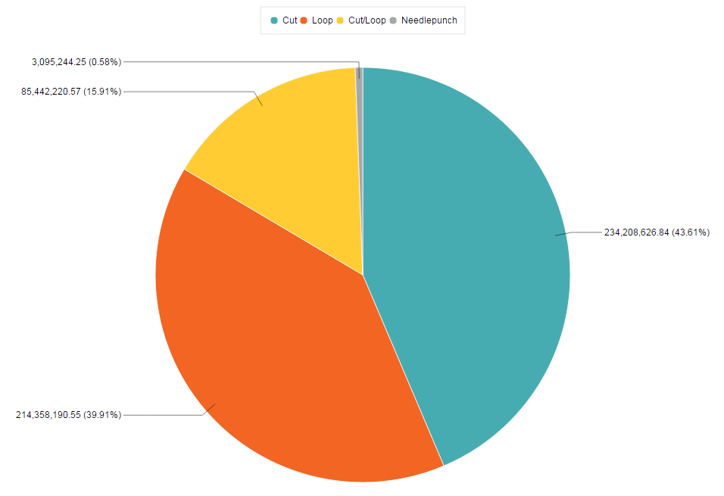
Interactive Analysis and Data Visualization
Easy to use, Web-based thin client for business users
Drag-and-drop for multi-dimensional “slice and dice” data analytics
Save, share, schedule, export, link to, embed
Notes:
All information is combined into an easy to use dashboard designed Provide your management with the complete picture
The level of interaction can be tailored to the user types / groups and delivered on all popular mobile platforms
Information be analyzed with sophisticated visualizations such as
Heat grids, Scatter graphs
Interactive geographic maps
3d graphs, and more
Logitech:
Out of the box reports / dashboards
Automatic alerts to uncover potential issues before they arise
Simplified their complex data integration processes, making them easier to maintain
Bottom Line quote: “Pentaho has improved our ability to manage the business effectively”

Slide 8
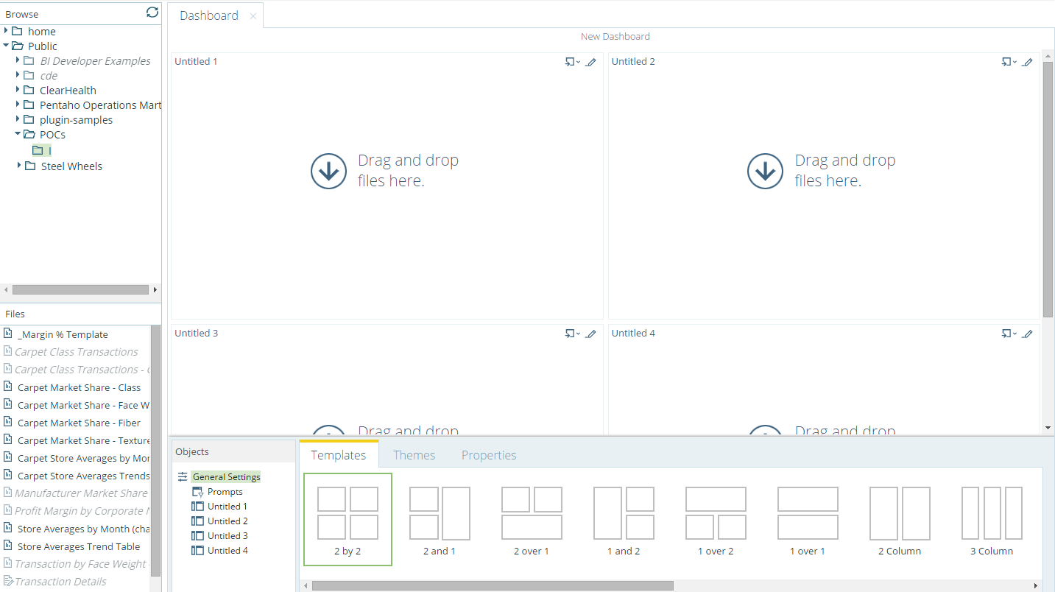
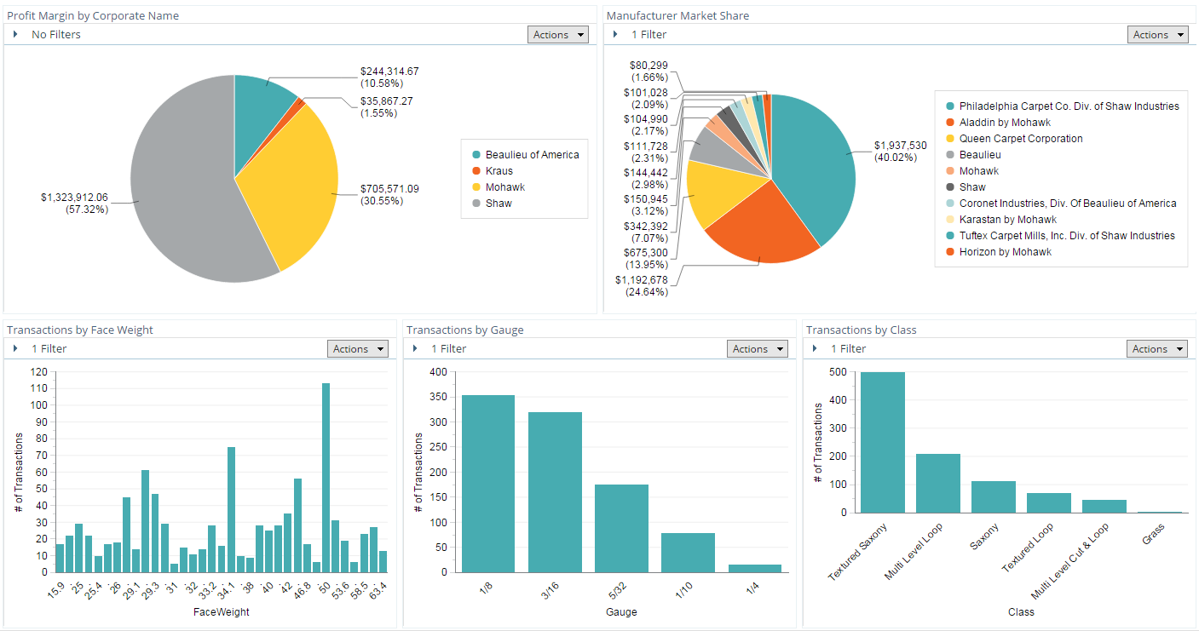
Self-Service Dashboards
Easy to use, Web-based thin client for business users
Template and theme-based for self-service dashboard assembly with no technical skills
Drag-and-drop saved content to include in dashboard
Notes:
Business users can build their own dashboards without IT intervention and related lead times and development cycles
Quickly build dashboards containing detailed, summarized, or anything in between
Change field lengths and formatting
Save the report and schedule it to be emailed on a specific time table
The template can be customized to get the exact look and feel
SilverChair:
Upon starting to use Pentaho immediately reduced data their monthly reports processing from as long as 3 weeks down to a simple nightly process, which sometimes takes as little as an hour to run
Any questions? Next we’ll talk about data integration
*************** Go to BA Demo ************************

Slide 9
Pentaho Data Integration
Data-agnostic solution for ETL, orchestration, blending, and more
What is PDI?
Graphical library of code-free data integration steps
Data agnostic – structured or unstructured
Scale-out architecture to meet demanding processing needs
Workflow orchestration, alerts, scheduling / event-driven
Notes:
Enrich , supplement, aggregate
Stream directly to a report for real time reporting
Write out to a file, a process, or any data store
Get real time reporting on sentiment analysis from social media
Highly scalable
Runs on natively multiple platforms like Hadoop, Spark, etc

Slide 10

Simplify Machine Learning
Ease the integration of machine learning in your business processes
Drag-drop data preparation and feature engineering
Support WEKA, R, Python, SparkML
Operationalize predictive model into existing data pipelines
Notes:
Let’s look at the example of an online retailer who uses machine learning.
Credit card companies including Visa (V) and MasterCard (MA) cover fraud losses of bricks-and-mortar stores, but online retailers are on their own. That means retailers with significant online presences such as Nordstrom and Macy's have to reimburse customers whose credit card numbers were used fraudulently to buy merchandise on the Internet. Online-only retailers including Amazon.com are on the hook for everything purchased fraudulently.
Currently, this anonymous retailer is struggling with increasing amounts of fraudulent credit card transactions resulting in high chargeback and reputation damage.
They’ve decided to deploy the power of predictive analytics using machine learning to fix the problem and have hired a team of data scientists.
It wasn’t easy to build a data science team with the skill set in high demand, and they realized that the data scientists were spending a lot of time getting the data in the right form that they could use for machine learning.
They wanted the data scientists to focus on applying their expertise in creating more accurate fraud detection techniques rather than spending their time coding to prepare data and feature engineer.
They chose Pentaho to help with all the 4 stages.
Pentaho enables visual drag-drop data preparation and feature engineering freeing the data scientists to concentrate on perfecting the fraud model
Pentaho supports R, Python, Spark MLLib and WEKA allowing the data scientists to work in the ML tool of their choice
The team can quickly deploy predictive models into existing Pentaho data pipelines enabling data scientists and data engineers to collaborate closely
Pentaho supports model updates and versioning without any rework
******* Demo Next*******

Slide 11
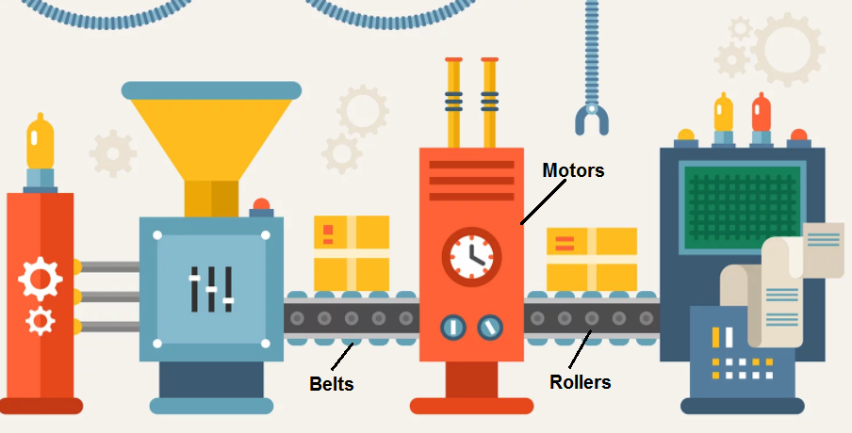
Integration For Holistic Monitoring Capabilities
Monitor the entire system at once
Dashboards and analytics allow overall as well as detailed view
Take advantage of predictive capabilities to optimize you predictive maintenance
Notes:
Let’s look at the example of an online retailer who uses machine learning.
Credit card companies including Visa (V) and MasterCard (MA) cover fraud losses of bricks-and-mortar stores, but online retailers are on their own. That means retailers with significant online presences such as Nordstrom and Macy's have to reimburse customers whose credit card numbers were used fraudulently to buy merchandise on the Internet. Online-only retailers including Amazon.com are on the hook for everything purchased fraudulently.
Currently, this anonymous retailer is struggling with increasing amounts of fraudulent credit card transactions resulting in high chargeback and reputation damage.
They’ve decided to deploy the power of predictive analytics using machine learning to fix the problem and have hired a team of data scientists.
It wasn’t easy to build a data science team with the skill set in high demand, and they realized that the data scientists were spending a lot of time getting the data in the right form that they could use for machine learning.
They wanted the data scientists to focus on applying their expertise in creating more accurate fraud detection techniques rather than spending their time coding to prepare data and feature engineer.
They chose Pentaho to help with all the 4 stages.
Pentaho enables visual drag-drop data preparation and feature engineering freeing the data scientists to concentrate on perfecting the fraud model
Pentaho supports R, Python, Spark MLLib and WEKA allowing the data scientists to work in the ML tool of their choice
The team can quickly deploy predictive models into existing Pentaho data pipelines enabling data scientists and data engineers to collaborate closely
Pentaho supports model updates and versioning without any rework
******* Demo Next*******

Slide 12
Recap
IoT Growth
Industry Figures
Monitoring for efficiency
Demo Business Analytics
Pentaho Data Integration / Machine Learning

Slide 13
Thank You !

